Slide 1


My dream job
Presentation by Wiktoria Tempes

Slide 2
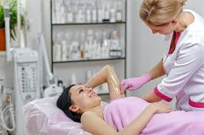
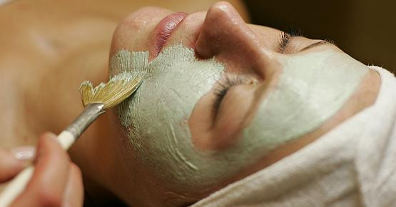
Women’s beautician damska kosmetyczka

Slide 3
The profession of a beautician is a profession classified as personal services, which includes activities related to the performance of beauty treatments.
This is not my dream job, but I could become a beautician.
I like being to with people and I like when a woman is satisfied with her appearance.
When I go to the beautician for nail manicure, I’m always happy.

Slide 4

Another advantage of this profession is the irregular working time.
It is a profession, that enables to met my family or even meet new people.

Slide 5

I am a communicative, smilling person and I think that I would work well in the profession of a beautician.

