Slide 1
My dream job…

Slide 2
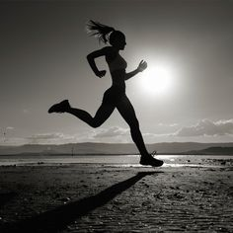
I'm still a kid and to be honest I don't know exactly who I want to be when I grow up that's why at this point I will write about my passion which is athletics

Slide 3
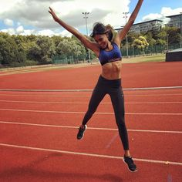
I have been practicing sports since I can remember, I start with dancing, moving to football, horse riding, karate, and finally I stopped at athletics

Slide 4
The career of an athlete involves many sacrifices
an athlete cannot spend every free moment and spend as much as he wants, his life is training, and training is a job that he must do to live
by putting some pressure on you, you cannot fail
There are many talented people in sport, so only hard work will take you to the top

Slide 5
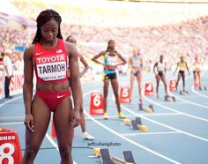
but nothing will be difficult for you if you love what you do
after each training well done, you will be proud of yourself and you will know that each victory was deserved by hard work
if you love your job and what you do, you can consider yourself a great winner

Slide 6
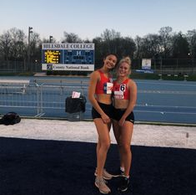
every job is hard, but it becomes more enjoyable if you like it and have people with you to support you

Slide 7
Athletics is my passion, for this moment I can say that I want to bind the future with it, but I'm only a child for now, so we'll see what the future is in store for me

Slide 8
Presentation made Wiktoria Mrowiec

