Slide 1
MY DREAM JOB
Martyna Ziomecka 1TUR

Slide 2
Tour guide
My dream job is a tour guide.
When I was younger I wanted to be a tour guide.
I was telling my mom a lot of information about a country I wanted to visit.
I read a lot of books about diffrent countries.
I like travelling because this makes me happy and I can visit new places in the world.

Slide 3
Perks of being a tour guide
When you work as a tour guide, you can meet new people and their habits.
A lot of trips around the world can deep our knowledge.
Travels educate! Me as a student I study hard English and French. These languages will help me in my profession.

Slide 4
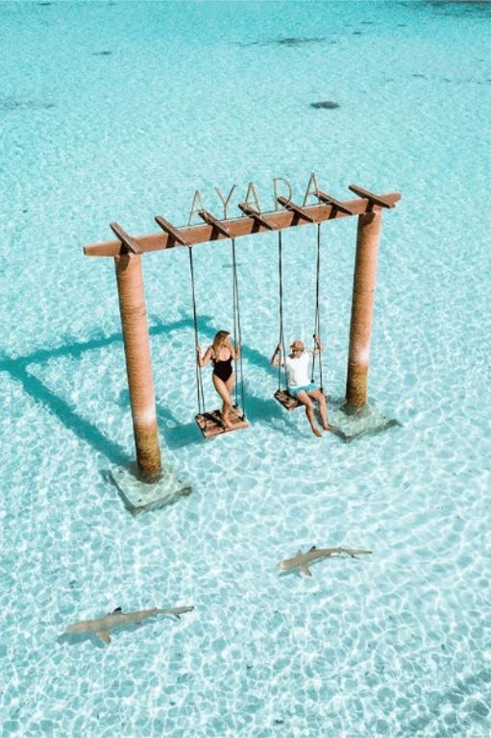
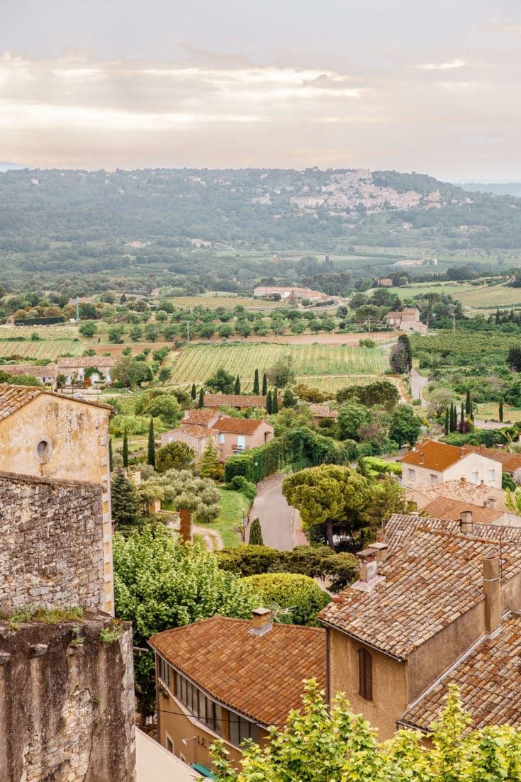
What should be a tour guide like?
As a tour guide you should have great language skills and be raedy to meet the requirements such as:
- communication skills
- convincing power
- interesting performance
- knowledge about country
- faculty of improvization
And many other skills …

Slide 5
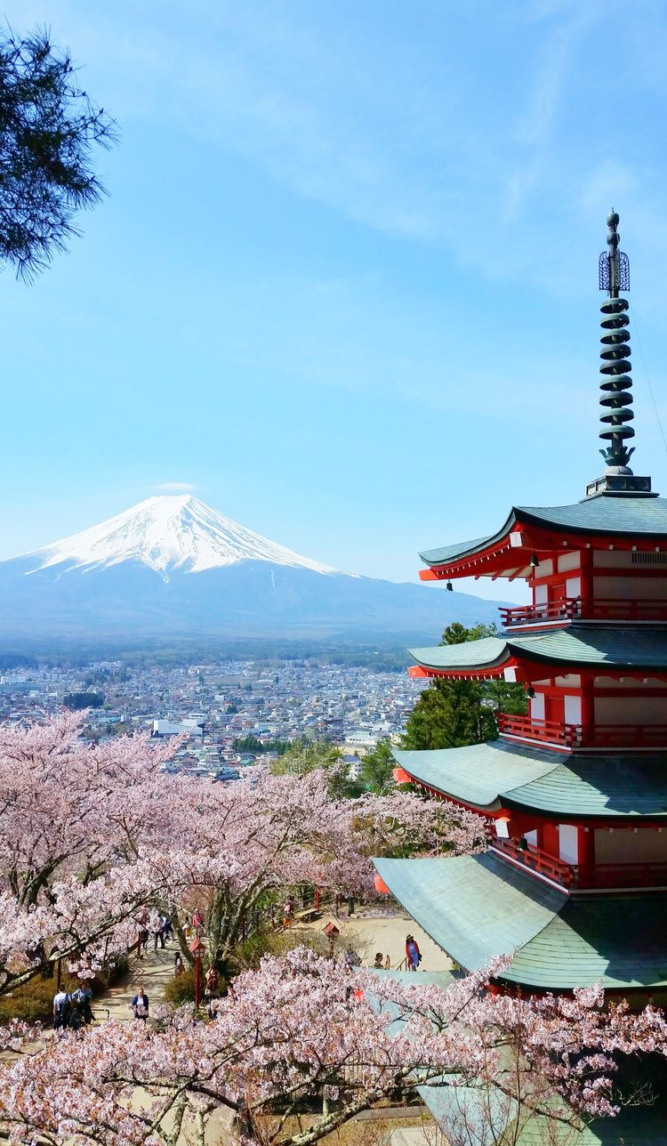
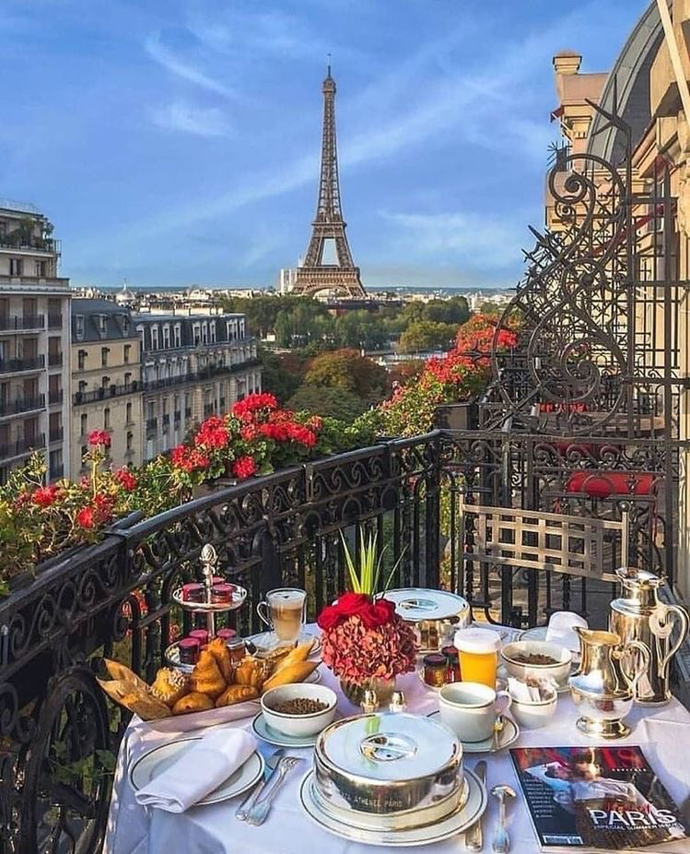
Summary
People who are all curious are suitable for this profession.
A good tour guide should have knowledge about diffrent countries.
I think this job is very attractive, also because of earnings.
In the future I want to be a good tour guide.

