Slide 1
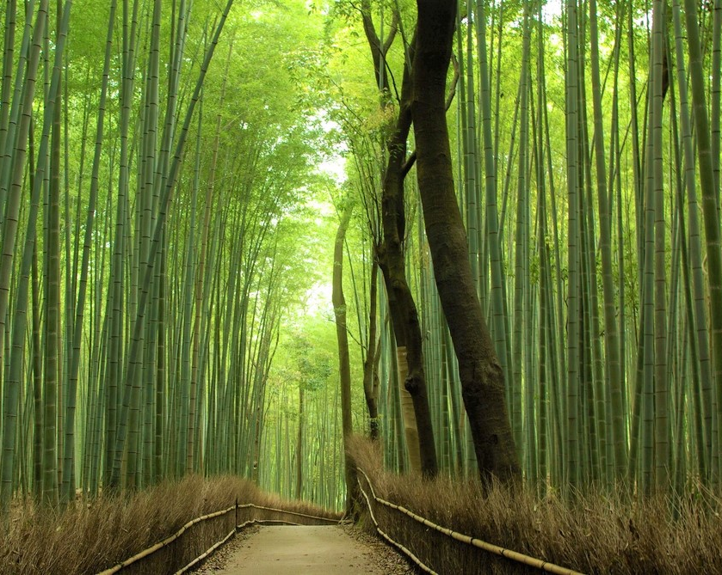
One of the most wonderful places in the world
Arashiyama Bamboo Grove

Slide 2
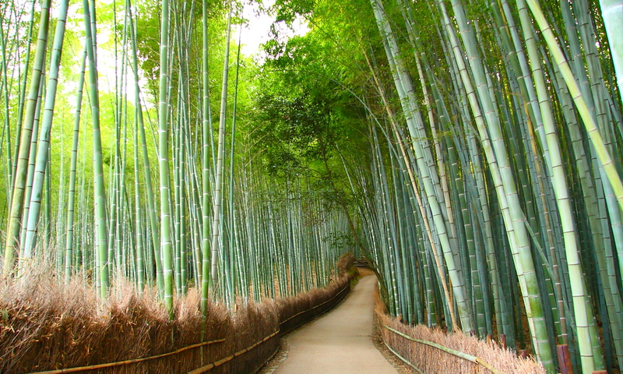
It’s also named Sagano Bamboo Forest.
This place is a natural forest of bamboo in Arashiyama, disctrict on the western outskirts of Kyoto.

Slide 3
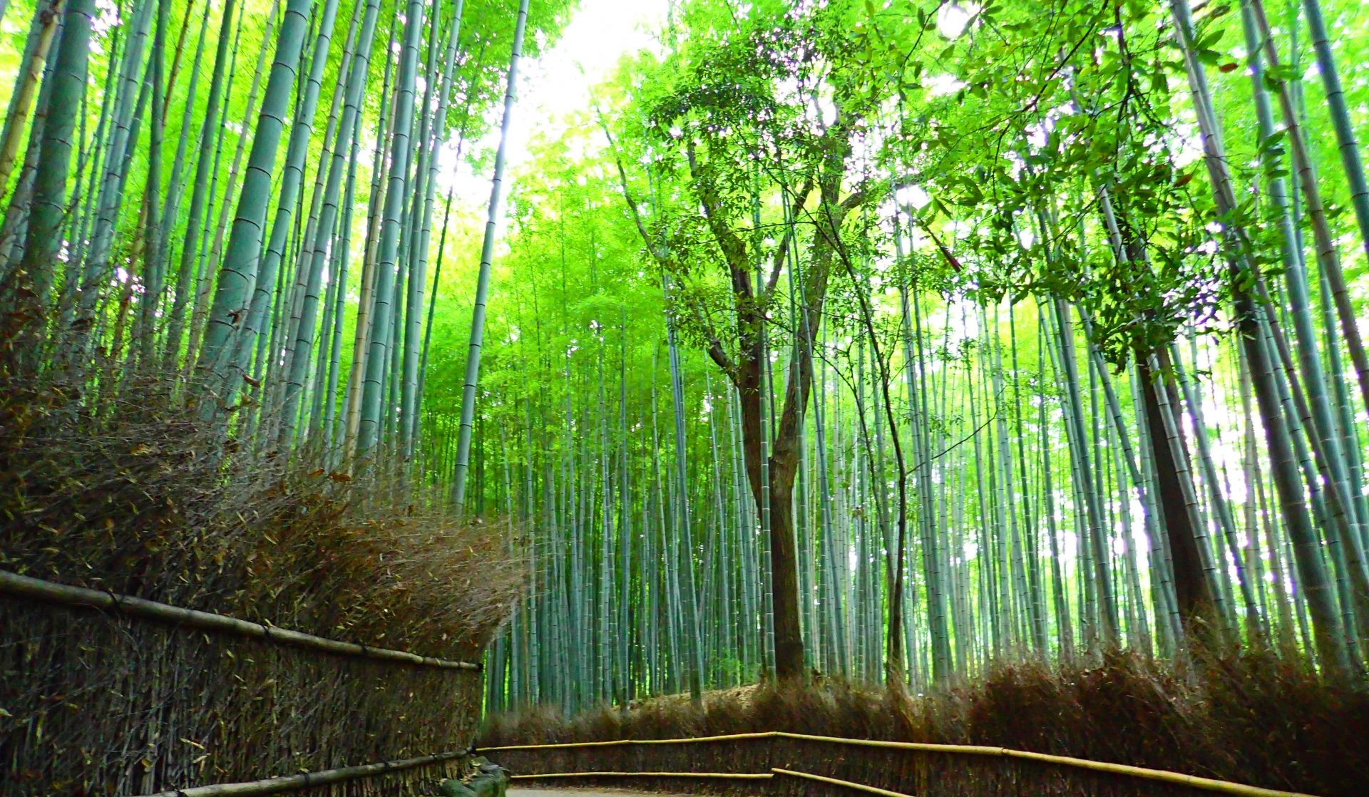
It’s mostly made of Moso Bamboo – giant timber bamboo native to China and Taiwan and naturalised in Japan. Height of these plants can reach 28 meters.

Slide 4
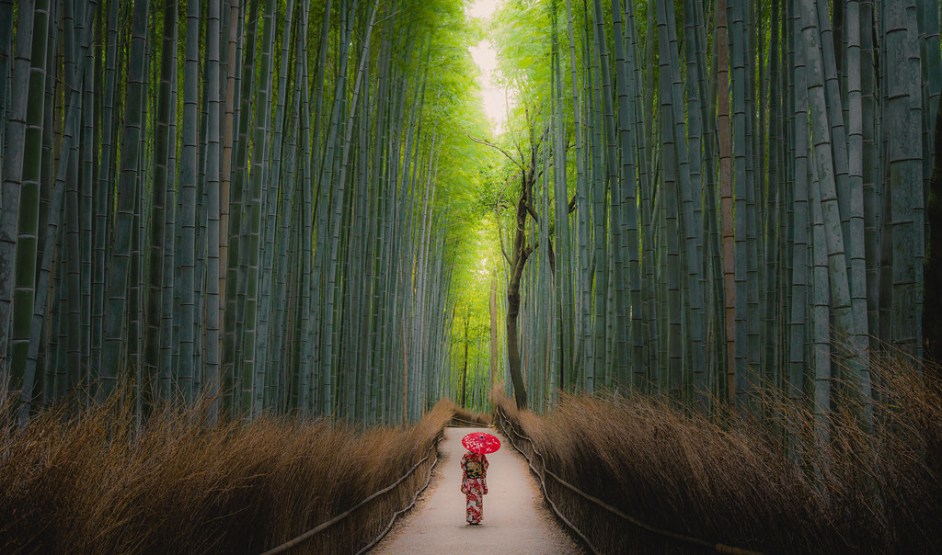
People say, that walking along the path among these bamboos feels like being in another world.

Slide 5
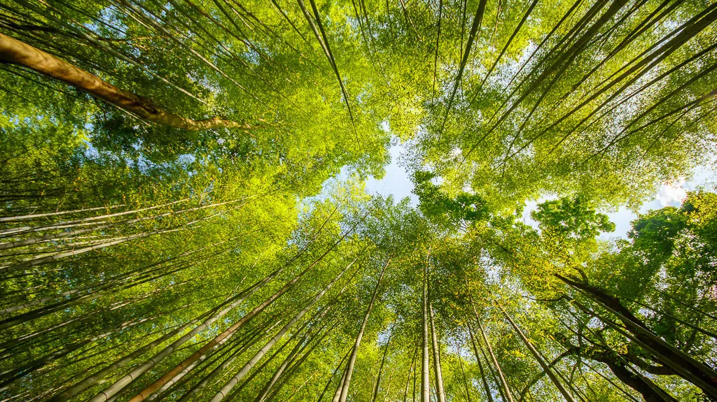
View on the sky in Bamboo Forest:

Slide 6
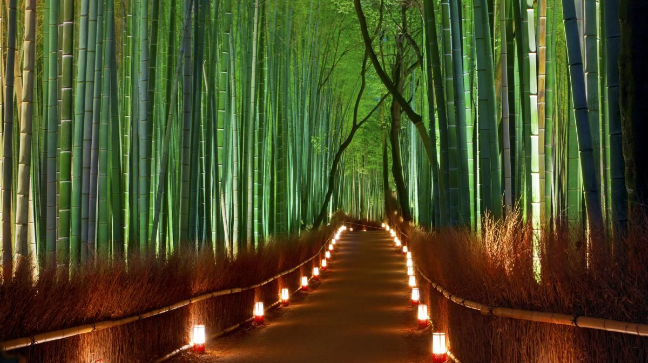
Bamboo Grove in the dark:

Slide 7
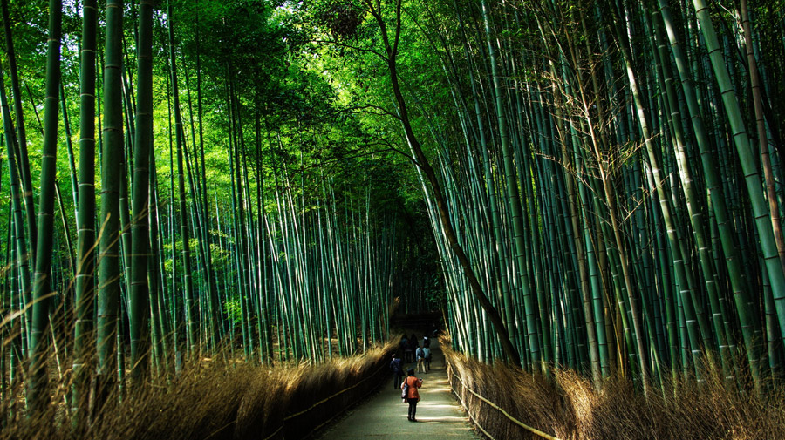
Would you like to go there?
THE END
Source of the phohtos: Google
Author: Zosia Wyszowska

