Slide 1
NATIONAL PARK KRKA WATERFALLS
Julia Misztal presents:

Slide 2
NATIONAL PARK „KRKA” WATERFALLS
These photos are taken by me.
There are many beautiful places in the world. I want to show you the most beautiful place which I have watched in my life.

Slide 3
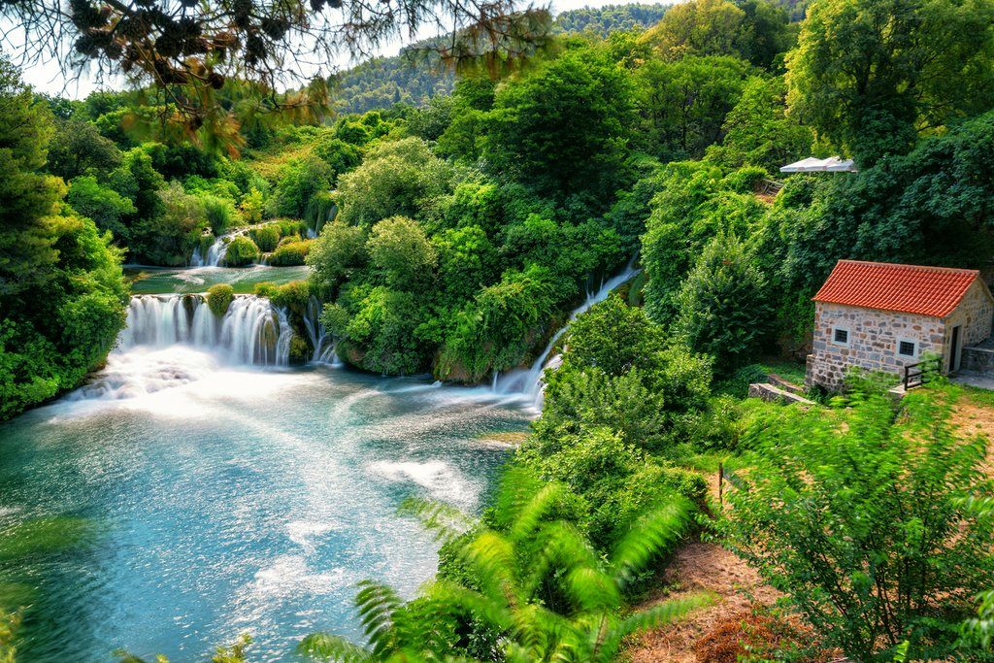
Two years ago I had oportunity to visit „Krka National Park” in Croatia.

Slide 4
„Krka” is really famous. There are plenty of waterfalls and streams in the National Park. The water is very clear and there are many fish in them.

Slide 5
A walk in the park takes about three hours, during wich you can admire amazing views.

Slide 6
The main highlight is the lake where you can swim and refresh your body.

Slide 7
Next to the lake , there are many trading posts where you can buy local food and souveniers.
I really recomend to visit the Krka National Park.

Slide 8
Thank you for your attention!

