Slide 1
The most beautiful place in the world~Bali
Alicja Kozak ii art p.s.p

Slide 2
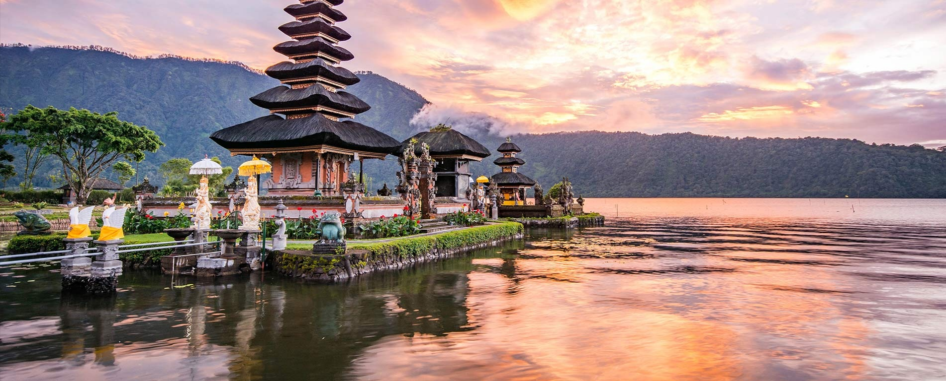

Slide 3
Bali - an Indonesian island in the Lesser Sunda Islands archipelago. It is situated in a chain of islands; it is separated from Java (to the west) by the Bali Strait and Lombok Island (to the east) by the Lombok Strait. It is an essential part of the Bali province

Slide 4
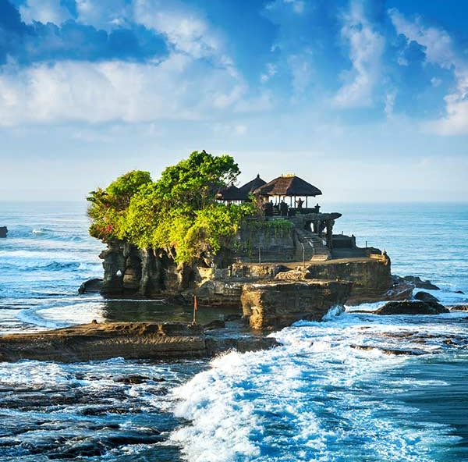

Slide 5
A month on the Bali
A monthly stay in a log is not as expensive as it seems. For a double room with a bathroom, you will pay from 800 PLN per month. A net of vegetables costs PLN 5, and you can eat lunch in a local restaurant from PLN 7. Beautiful Instagram dishes are at Warsaw prices. Renting a small scooter for a month costs PLN 150, and full refueling costs PLN 10. Alcohol and dairy products are the most expensive. Of course, the more amenities the more expensive it is. In general, you will survive a month in Bali for less than PLN 2,500.

Slide 6
strange laws
There are strange recipes on the log, such as:
~ There is a shame penalty for stealing
~ The death penalty for drugs
~ You can go to jail for begging
~ The hotel must be lower than the palm trees

Slide 7
The price of attraction on the Bali
Admission to 4 waterfalls from which you can jump costs PLN 26, as well as admission to the temple where beautiful photos are taken. Entry to an active volcano at sunrise costs PLN 70 and it is the most expensive attraction. We will enter the beach from PLN 2.50 for the whole day.

Slide 9
summary
In summary, it is worth going there because there are beautiful views, great attractions, and low costs. The only problem is the trip there because it costs PLN 2700, and in the era of covid-19 PLN 4000. After all, I think no one will be disappointed to stay there.

Slide 11
Thank you for your attention 😁🙂

